Slide 1


ENGR 1111 Intro to Engineering: Civil Engineering Fall 2022 Part 8: Risk Assessment

Slide 2
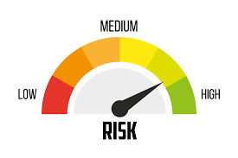
Part 8: Risk Assessment
Objectives
Concept or perception of risk
How to calculate risk
The steps involved in performing risk assessments
Environmental impact statements

Slide 3
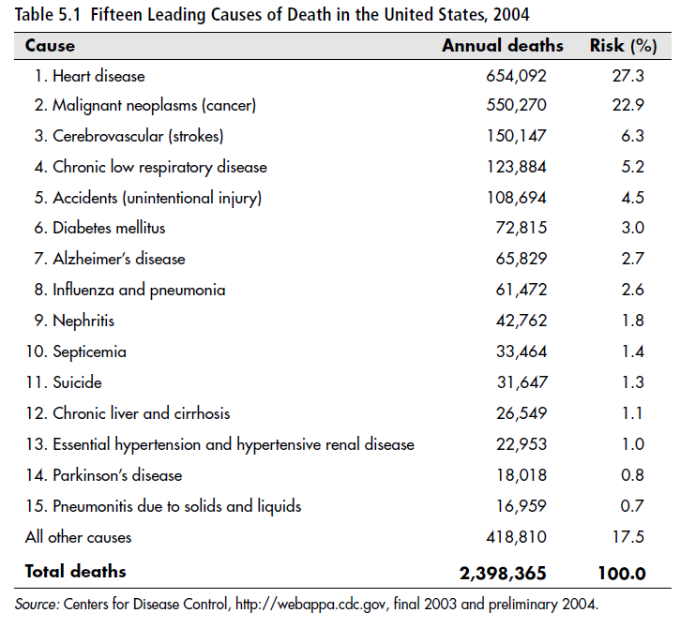
Part 8: Risk Assessment
Concept or Perception of Risk:

Slide 4
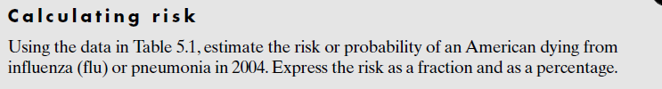
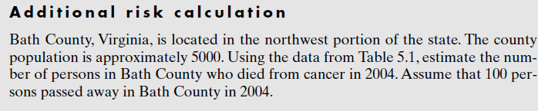
Part 8: Risk Assessment
Concept or Perception of Risk:

Slide 5
Part 8: Risk Assessment
Concept or Perception of Risk:
Risk vs Safety:
Risk – probability that an adverse effect or outcome will occur
Safety – probability that no adverse effect will occur
Risk:
Expressed numerically and has no units
Reported as a fraction between 0 and 1 or as a percentage
The closer risk is to 1, the higher the probability of the event happening
May be calculated as lifetime risk or annual risk

Slide 6
Part 8: Risk Assessment
Risk Assessment:
Risk is a function of hazards and exposures
Hazard – anything that produces an adverse effect on human health and the environment or ecosystem
Exposure – qualitative or quantitative assessment of contact to the skin or body by a chemical

Slide 7
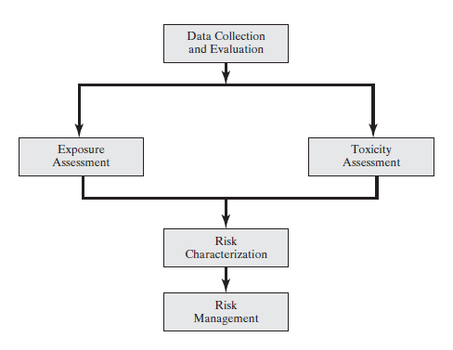
Part 8: Risk Assessment
Data Collection and Evaluation
Toxicity Assessment
Exposure Assessment
Risk Characterization
Risk Management

Slide 8
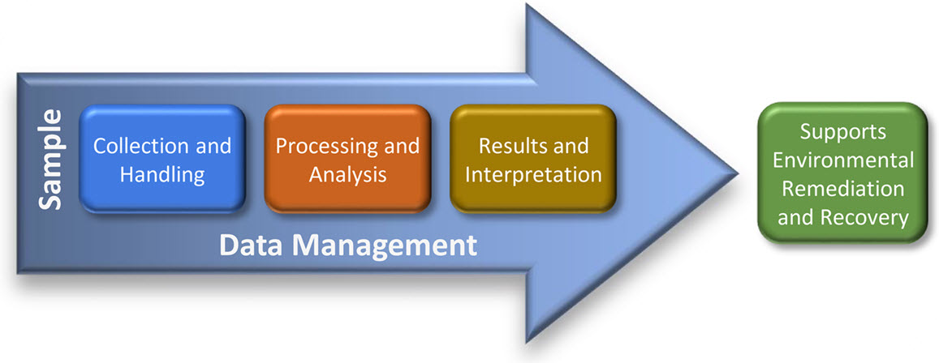
Part 8: Risk Assessment
Data Collection and Evaluation
Baseline Risk Assessment Data
Identification of potential contaminants
Concentration of contaminants
Characterization of sources and environmental setting
Develop a Sampling Plan
A sampling plan will reflect background levels of naturally occurring and anthropogenic levels of chemicals
Environmental Protection Agency’s Environmental Sampling and Analytical Methods Program

Slide 9
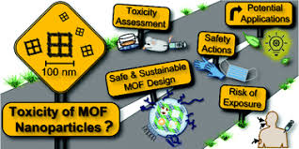
Part 8: Risk Assessment
Toxicity Assessment
Toxicity involves studying the adverse effects of exposure of living organisms to chemicals or toxicants
The result of exposure depends on an individual’s susceptibility
Factors that affect susceptibility:
Gender
Age
Diet
Genetics
Prior Exposure

Slide 10
Part 8: Risk Assessment
Toxicity Assessment
The toxicity component of the baseline risk assessment considers:
Types of adverse health effects associated with the exposure to specific chemicals
The relationship between the magnitude of exposure and adverse effects
Related uncertainties of a compound’s cancer-causing ability (carcinogenicity) to humans

Slide 11
Part 8: Risk Assessment
Toxicity Assessment
Hazard Identification – process of determining whether exposure to a toxicant is linked to a particular health effect (examples: cancer, birth defects, etc.)
Many times, studies are conducted on animals or tissue. These studies are called bioassays
Toxicants can promote acute toxicity (short period of time) or chronic toxicity (long term exposure)
Chronic toxicity may result in mutation of genetic material
Carcinogens – toxicants capable of causing cancer
Teratogens – toxicants capable of causing birth defects

Slide 12
Part 8: Risk Assessment
Toxicity Assessment
Dose-response Assessment – process of evaluating the relationship between the level of exposure to the toxicant and the extent of adverse effect on the individual
Carcinogenic or noncarcinogenic
Acute or chronic
Dose – mass of a chemical received by the exposed individual, expressed in milligrams per kilogram (mg/kg) of body weight

Slide 13
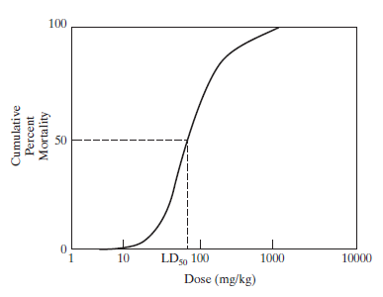

Part 8: Risk Assessment
Toxicity Assessment
The quantity of a specific chemical required to kill an organism normally follows a S-shaped curve
The dose at which 50% of the organisms die is the median lethal dose (LD₅₀)

Slide 14
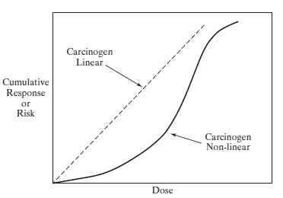

Part 8: Risk Assessment
Toxicity Assessment
Instead of mortality, the response may be reported as the probability or risk of causing cancer

Slide 15
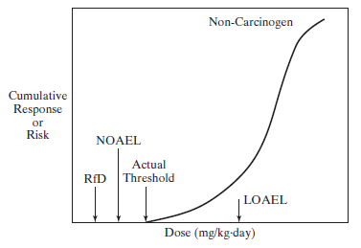

Part 8: Risk Assessment
Toxicity Assessment
Noncarcinogenic effects
Lowest-observed-adverse-effect level (LOAEL) – lowest dose administered that elicits an adverse response
No-observable-adverse-effect level (NOAEL) – highest dose administered that does not create an adverse effect
Reference dose (RfD) – generally estimated by
dividing the NOAEL by an uncertainty factor of 10 (minimal uncertainty), 100, or 1000 (less certainty)

Slide 16

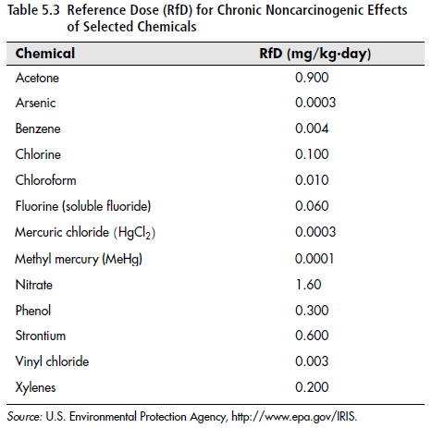
Part 8: Risk Assessment

Slide 17
Part 8: Risk Assessment
Toxicity Assessment
Mathematical Modeling of Dose-Response Curves
One-hit model
Assumes that a single chemical or toxicant will result in the formation of a tumor in the exposed individual
Multi-stage model
Based on the multistage formation of tumors that is caused by a sequence of events
The Environmental Protection Agency uses a multi-stage model called the linearized multistage model that assumes a linear relationship between risk and dose at low doses
Slope factor (SF) – slope of the dose-response curve

Slide 18

Part 8: Risk Assessment
Toxicity Assessment
Slope Factor
Where,
Slope factor = slope of dose-response curve, (kg*day)/mg
Incremental Lifetime Cancer Risk = incremental risk of cancer in a lifetime above the background rate, dimensionless
Chronic Daily Intake (CDI) = the average dose of toxicant absorbed per kilogram of body weight over an entire lifetime, (70 years), mg/(kg*day)

Slide 19
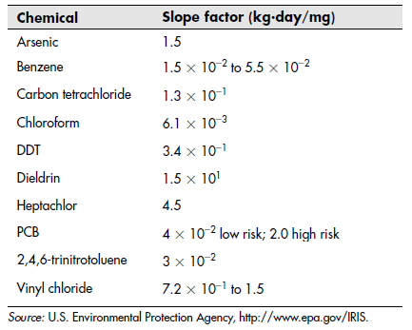
Part 8: Risk Assessment
Toxicity Assessment

Slide 20
Part 8: Risk Assessment
Exposure Assessment
A toxicant can enter the body by:
Inhalation - air
Ingestion – food and liquids
Absorption
Exposure media:
Surface water
Groundwater
Sediment
Air
Soil and dust
Food

Slide 21
Part 8: Risk Assessment
Exposure Assessment
Evaluating toxicant releases
Identifying exposed populations and potential pathways
Estimating exposure-point toxicant concentrations
Estimating toxicant intakes for specific pathways
Exposure Period
Acute (1 day)
Subacute (10 days)
Subchronic (2 weeks to 7 years)
Chronic (7 years to lifetime)

Slide 22

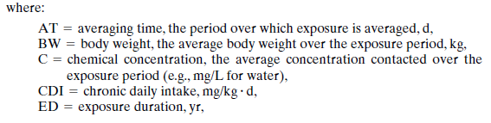

Part 8: Risk Assessment
Exposure Assessment
Generic equation for estimating chronic daily intake (CDI)

Slide 23
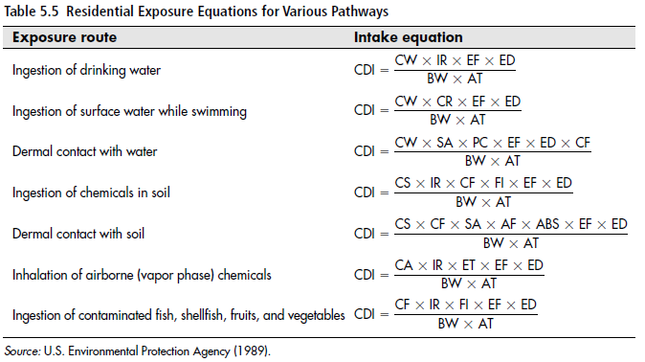
Part 8: Risk Assessment
Exposure Assessment
Reasonable Maximum Exposure (RME) is determined by the EPA

Slide 24
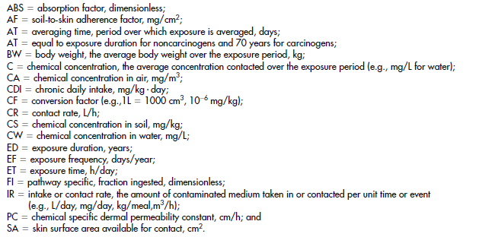
Part 8: Risk Assessment
Exposure Assessment

Slide 25
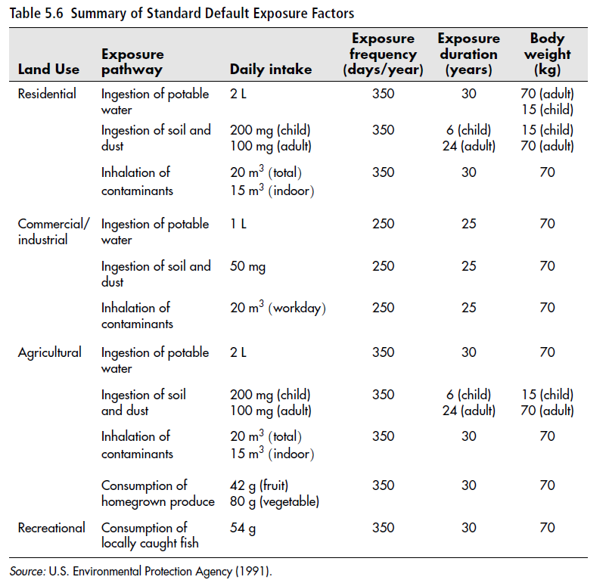
Part 8: Risk Assessment
Exposure Assessment

Slide 26
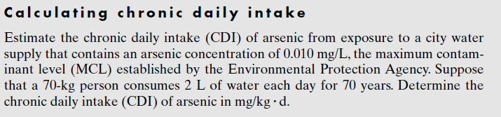
Part 8: Risk Assessment
Exposure Assessment

Slide 27
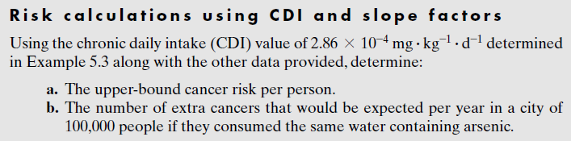
Part 8: Risk Assessment
Risk Characterization
Carcinogens

Slide 28

Part 8: Risk Assessment
Risk Characterization
Noncarcenogenics
EPA uses a hazard index for noncarcinogenic compounds
When more than one non-carcinogenic compound is present, the sum of HIs is determined.
A hazard index of less than 1.0 is acceptable

Slide 29
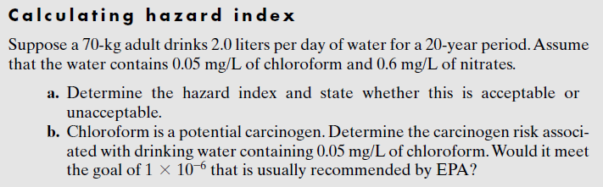
Part 8: Risk Assessment
Risk Characterization

Slide 30
ENGR 1111 Intro to Engineering: Civil Engineering Fall 2022 Part 8: Risk Assessment

